Slide 1
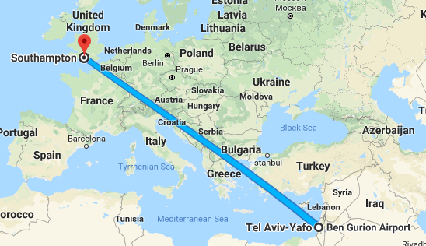
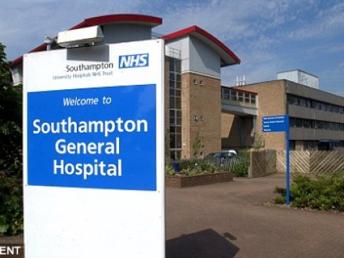
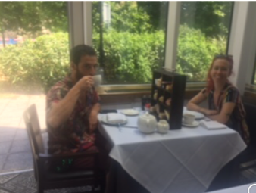
18 Jun – 06 July 2018
The EPUAP exchange scholarship
I am grateful to EPUAP exchange scholarship for giving me the opportunity
to gain new knowledge and skills in the field of Medical Device-related Pressure Ulcers, as well as to network with international collaborators who lead research in the field.
Southampton General Hospital
Field studies
Both the host (University of Southampton, Prof. Dan Bader) and visiting (Tel Aviv University, Prof. Amit Gefen) research groups are interested in examining mechanisms of medical device-related pressure ulcers (MDRPUs), by employing different experimental techniques used in a clinical setting and computational methodologies to design safe medical devices than can minimize the risk for MDRPUs.
English Tea Ceremony
Sunny Southampton

Slide 2
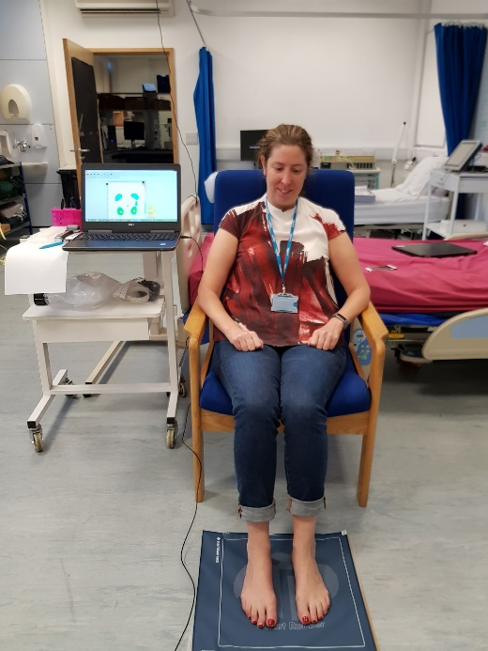
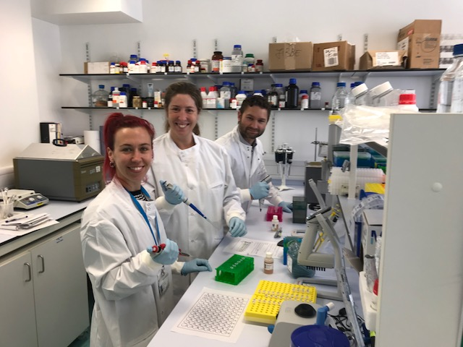
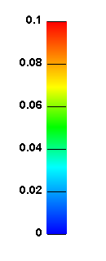
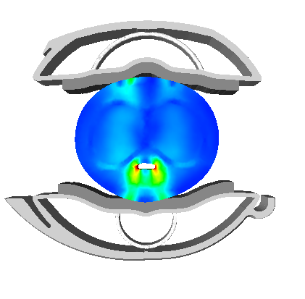
18 Jun – 06 July 2018
This EPUAP internship has included research in:
1. Biomechanics lab
Physiological monitoring of the foot microvasculature, inflammation and seated plantar pressures in healthy and diabetic elderly population.
Dr. Fran Henshaw
2. Biochemistry lab
Support experimental research investigating inflammatory biomarkers of skin pre- and post-loading of a range of medical devices.
3. Imaging and modelling
MRI data analysis - A series of MRI scans from a small cohort of patients with medical devices in-situ – penile clamps were analyzed to establish tissue strains.
These data were used to support the development of a finite element model to predict compression of soft tissues when subjected to a penile clamp
I was also able to take part in monitoring lymphatic activity with near-infrared imaging as part of another study.
Dr. Peter Worsley, Dr. Fran Henshaw and Lea Cohen (from right to left)
A finite element model

Slide 3
18 Jun – 06 July 2018
Summary
PERSONAL SUMMARY
Skills Learnt
Biochemistry analysis to detect inflammatory cytokines from loaded skin tissues
Lymphatic imaging to assess the effects of load on dermal vessel patency
Physiological monitoring of soft tissues, including transcutaneous tissue gases.
Skills Shared
Image processing and analysis techniques to determine soft tissue strain during medical device application
Finite element modelling of medical devices attached to vulnerable tissues
Outputs
1. Lemmens J., Peko Cohen L., Worsley, PR., Everett, C.,Broadbridge J., Gefen, A., Rees R, Drake M, Macaulay, M., Fader, M., Bader, DL. Magnetic Resonance Imaging to estimate Tissue deformations during penile clamp application. BMC Urology

